Slide 1
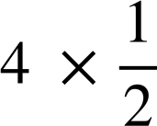

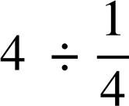
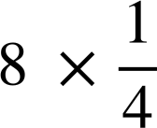
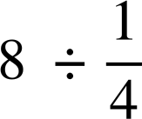

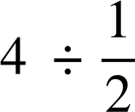
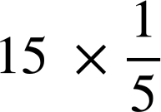
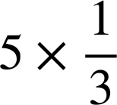
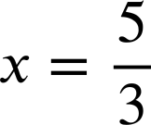
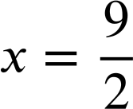

Solving simple linear equations with a multiplicative step
Task A: Multiplicative steps using representations
Match up the bar models with the calculations which will find the solution. There may be more than one calculation for each diagram.
a)
x
x
d)
4
4 ÷ 2
4
4 × 4
b)
x
x
x
x
8
8 ÷ 4
e)
c)
4 × 2
8
8 × 4
4
2) Use these bar models to find the value of x
a)
x
x
x
x
x
d)
x
x
x
15
x = 3
5
b)
15
15 ÷ 3
e)
18
18 ÷ 4
x
x
x
x = 5
x
x
x
x
c)
30
30 ÷ 10
f)
10 × 5
x
x
x
x
x
x
x
x
x
x
x = 3
10
x = 50

Slide 2



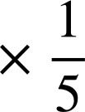

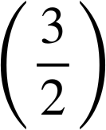
Solving simple linear equations with a multiplicative step
Task B: Writing solutions algebraically
Solve each equation.
a)
f)
2x | = | 18
2x ÷ (2) | = | 18 ÷ (2)
x | = | 9
−8x | = | 18
−8x ÷ (−8) | = | 18 ÷ (−8)
x | =
6x | = | 30
6x ÷ (6) | = | 30 ÷ (6)
x | = | 5
b)
g)
 | = | 13
× (4) | = | 13 × (4)
x | = | 52
c)
h)
5x | = | 9
5x …. | = | 9
x | =
 | = | −10
× | = | −10 ×
x | = | −15
d)
i)
21x | = | −21
21x ÷ (21) | = | −21 ÷ (21)
x | = | −1
−1.4x | = | 4.2
−1.4x ÷ (1.4) | = | 4.2 ÷ (1.4)
−x | = | 42 ÷ (14)
−x | = | 3
x | = | −3
e)
−2x | = | −12
−2x ÷ (−2) | = | −12 ÷ (−2)
x | = | 6
Mathematics in Education and Industry
v2.3

